Slide 1
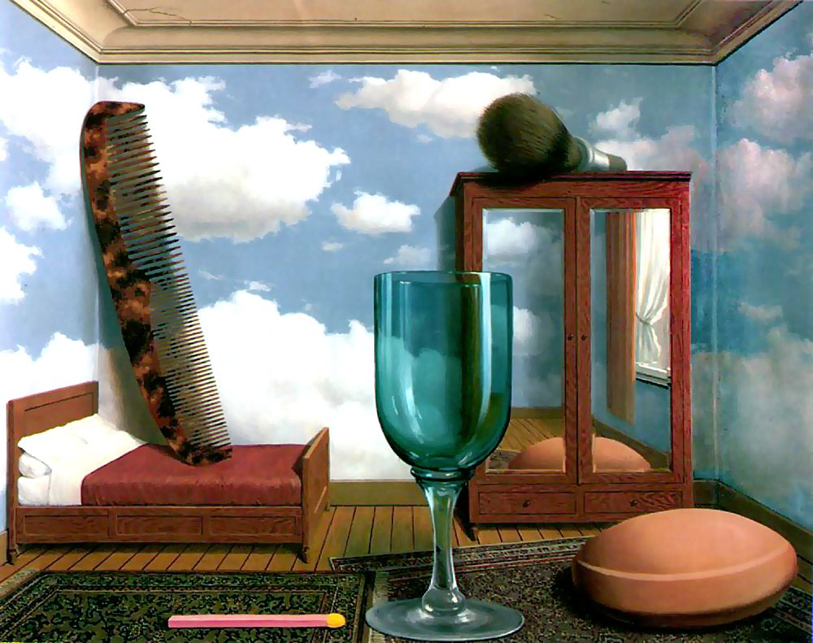
Single-view metrology
R. Magritte, Personal Values, 1952
Many slides adapted from S. Seitz, D. Hoiem

Slide 2

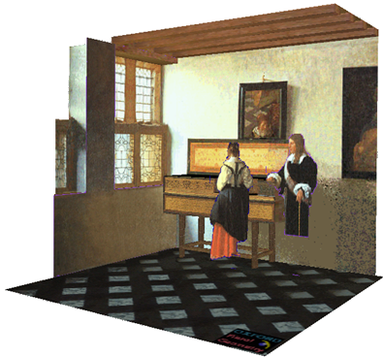
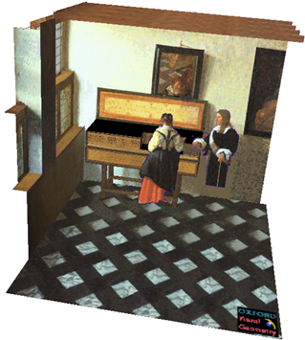
Single-view metrology
Given a certain set of assumptions, can we recover 3D information from a single image?
J. Vermeer, Music Lesson, 1662
A. Criminisi et al. Bringing Pictorial Space to Life: computer techniques for the analysis of paintings,
Proc. Computers and the History of Art, 2002

Slide 3
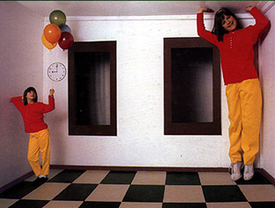
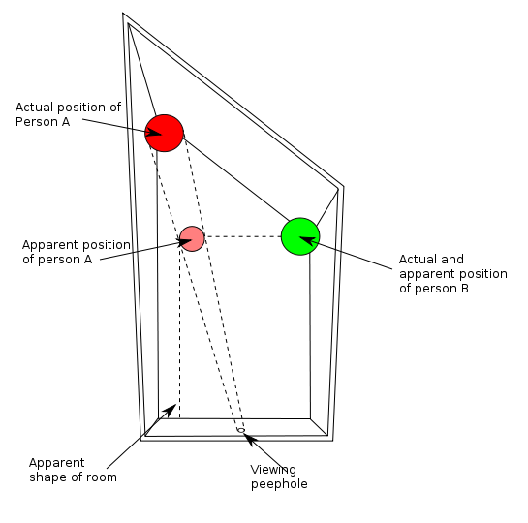
Reminder: Beware!
http://en.wikipedia.org/wiki/Ames_room

Slide 4
Outline
Vanishing points and vanishing lines
Camera calibration using vanishing points
Measurements from a single image
Applications of single-view metrology

Slide 5
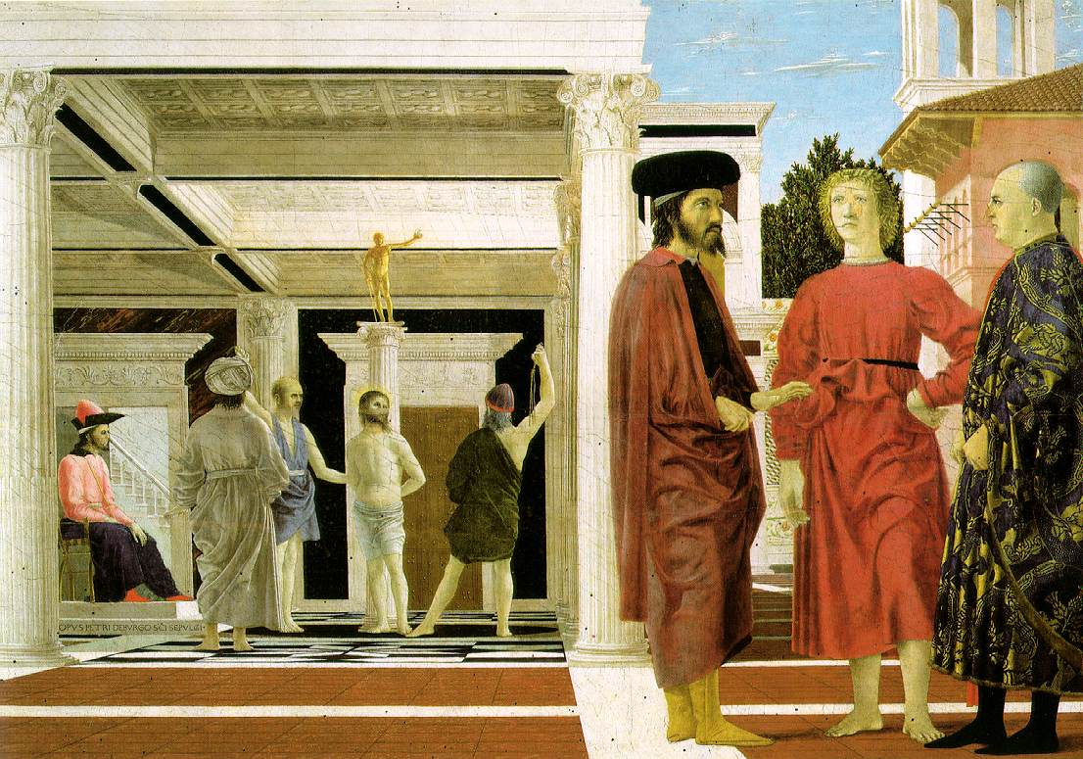
Vanishing points
Piero della Francesca, Flagellation of Christ, 1455-1460

Slide 6
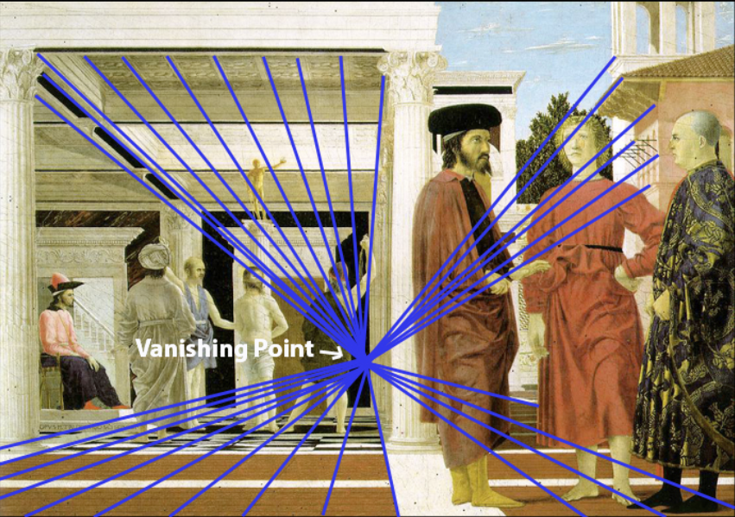
Vanishing points
Parallel lines meet at a vanishing point
Figure source
Piero della Francesca, Flagellation of Christ, 1455-1460

Slide 7
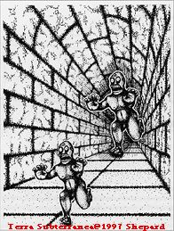
Converging lines are a powerful perspective cue
Slide by Steve Seitz

Slide 8
Constructing the vanishing point of a line
image plane
vanishing point
line in the scene
camera
center
What about another line going in the same direction?
Adopted from S. Seitz

Slide 9
Do all parallel lines converge to a vanishing point?
Piero della Francesca, Flagellation of Christ, 1455-1460

Slide 10
Do all parallel lines converge to a vanishing point?
Not parallel lines that are also parallel to the image plane!
Piero della Francesca, Flagellation of Christ, 1455-1460

Slide 11
Vanishing lines of planes
Each family of parallel planes is associated with a vanishing line in the image
Vanishing line of the ground plane
Piero della Francesca, Flagellation of Christ, 1455-1460

Slide 12
Constructing the vanishing line of a plane
Figure source: S. Seitz

Slide 13
Constructing the vanishing line of a plane
camera
center
plane in the scene
Figure source: S. Seitz

Slide 14
Constructing the vanishing line of a plane
camera
center
plane in the scene
Figure source: S. Seitz

Slide 15

Horizon: Vanishing line of the ground plane
What can the horizon tell us about the relative height of scene points and the camera?
camera
center
ground plane
Image source: S. Seitz
Notes:
Is this parachutist higher or lower than the person taking this picture?
Lower—he is below the horizon

Slide 16
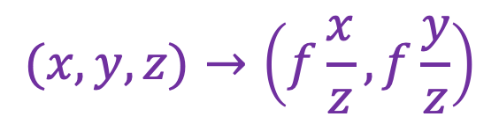
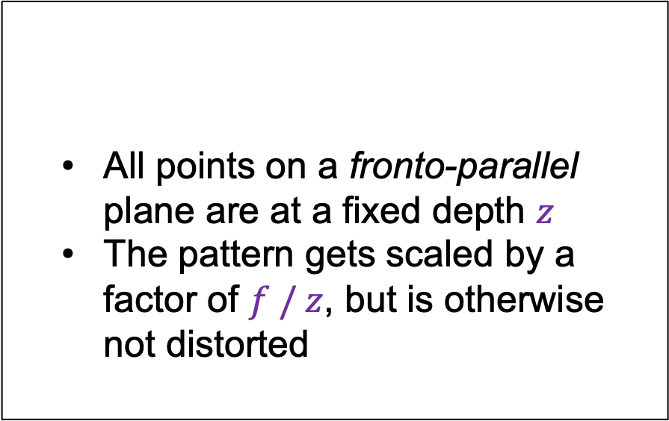
Projection of planes
Are there planes that don’t have vanishing lines?
  All points on a fronto-parallel plane are at a fixed depth $z$
  The pattern gets scaled by a factor of $f / z$, but is otherwise not distorted
$$(x,y,z)→\left(f\frac{x}{z},f\frac{y}{z}\right)$$
Piero della Francesca, Flagellation of Christ, 1455-1460

Slide 17
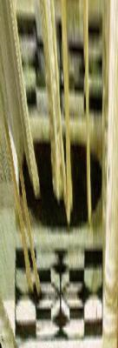
Projection of planes
  Patterns on non-fronto-parallel planes are distorted by
  a 2D homography
Piero della Francesca, Flagellation of Christ, 1455-1460

Slide 18
Outline
Vanishing points and vanishing lines
Camera calibration using vanishing points

Slide 19
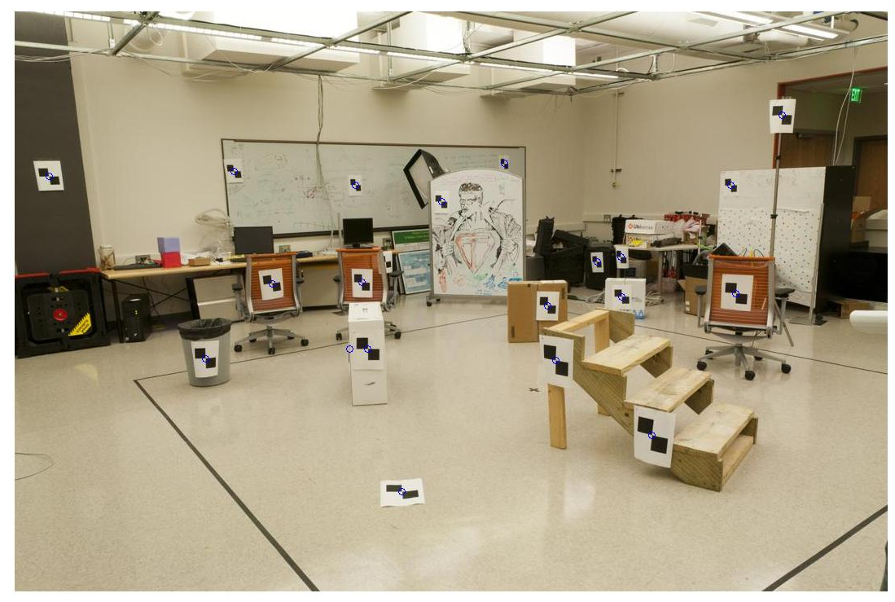
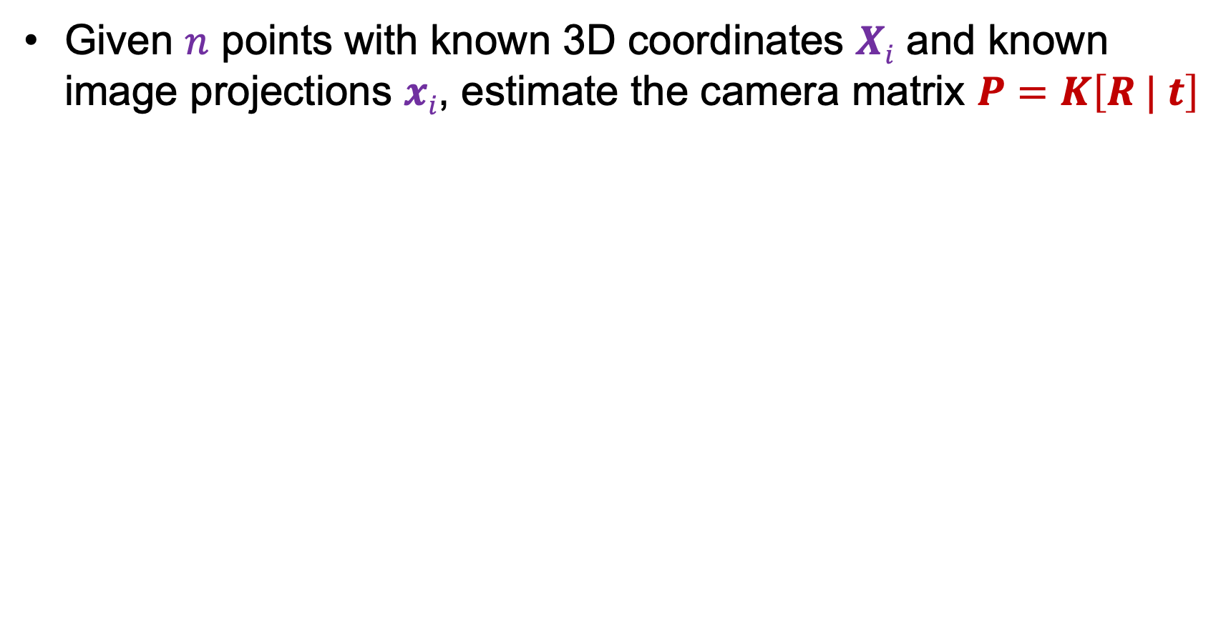
Recall: Camera calibration
Given $n$ points with known 3D coordinates $Xi$ and known image projections $xi$, estimate the camera matrix $P=K\left[R | t\right]$
Known 2D image coords
Known 3D locations
880 214
43 203
270 197
886 347
745 302
943 128
476 590
419 214
317 335
783 521
235 427
665 429
655 362
427 333
412 415
746 351
434 415
525 234
716 308
602 187
312.747 309.140 30.086
305.796 311.649 30.356
307.694 312.358 30.418
310.149 307.186 29.298
311.937 310.105 29.216
311.202 307.572 30.682
307.106 306.876 28.660
309.317 312.490 30.230
307.435 310.151 29.318
308.253 306.300 28.881
306.650 309.301 28.905
308.069 306.831 29.189
309.671 308.834 29.029
308.255 309.955 29.267
307.546 308.613 28.963
311.036 309.206 28.913
307.518 308.175 29.069
309.950 311.262 29.990
312.160 310.772 29.080
311.988 312.709 30.514
Image credit: J. Hays

Slide 20
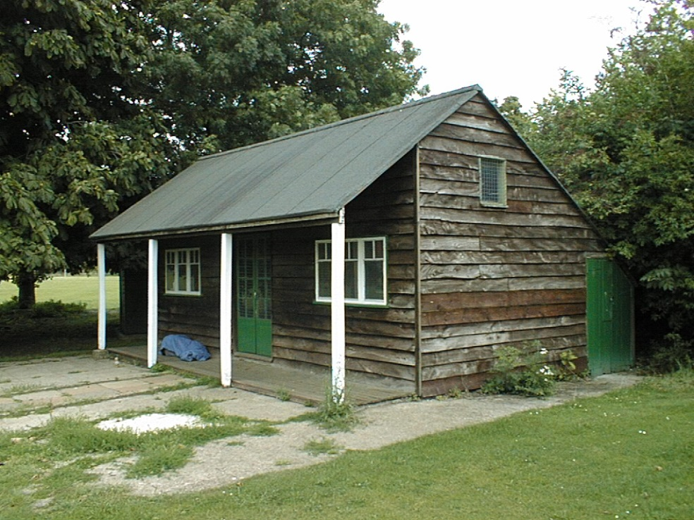
Camera calibration using vanishing points
If world coordinates of reference 3D points are not known,
we can use vanishing points of three orthogonal directions
Source: A. Efros, A. Criminisi

Slide 21
Camera calibration using vanishing points
If world coordinates of reference 3D points are not known,
we can use vanishing points of three orthogonal directions
Vertical vanishing
point
Vanishing
line
Vanishing
point
Vanishing
point
Source: A. Efros, A. Criminisi

Slide 22

Computing vanishing points
$$v$$

Slide 23

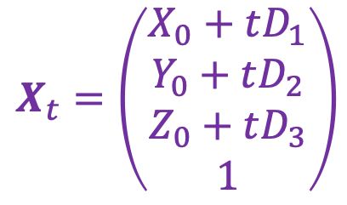


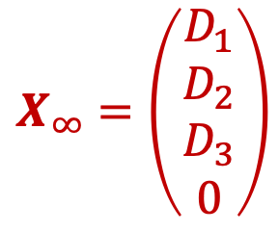
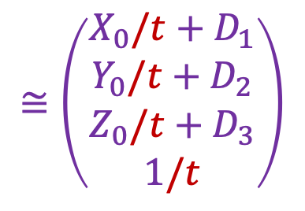
Computing vanishing points
$$v$$
$$X_{t}$$
$$X_{0}$$
Let’s parameterize the line using point $X_{0}={(X_{0},Y_{0},Z_{0},1)}^{T}$ and direction vector $D={(D_{1},D_{2},D_{3})}^{T}$:
$$X_{t}=\left(\begin{aligned}X_{0}+tD_{1} \\ Y_{0}+tD_{2} \\ Z_{0}+tD_{3} \\ 1\end{aligned}\right)$$
$$≅\left(\begin{aligned}X_{0}/t+D_{1} \\ Y_{0}/t+D_{2} \\ Z_{0}/t+D_{3} \\ 1/t\end{aligned}\right)$$
$$X_{∞}=\left(\begin{aligned}D_{1} \\ D_{2} \\ D_{3} \\ 0\end{aligned}\right)$$
$X∞$ is a point at infinity, $v$ is its projection: $v≅PX∞$

Slide 24
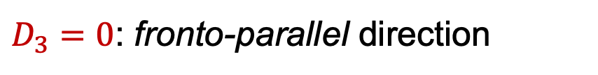
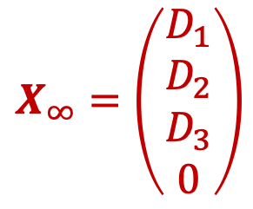
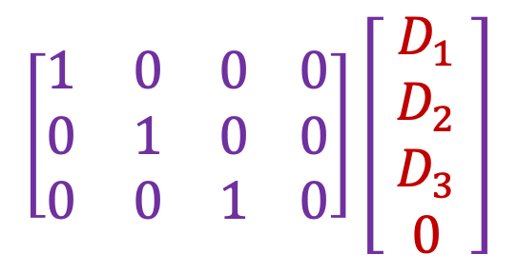
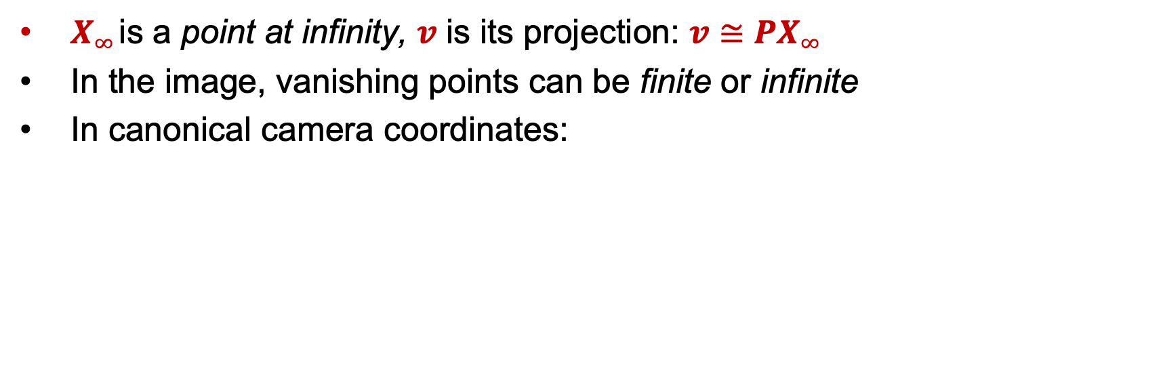
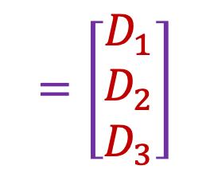
Computing vanishing points
$$X_{∞}=\left(\begin{aligned}D_{1} \\ D_{2} \\ D_{3} \\ 0\end{aligned}\right)$$
$$v$$
$$X_{t}$$
$$X_{0}$$
$X∞$ is a point at infinity, $v$ is its projection: $v≅PX∞$
In the image, vanishing points can be finite or infinite
In canonical camera coordinates:
$$\left[\begin{matrix}1 & 0 & 0 0 \\ 0 & 1 & 0 0 \\ 0 & 0 & 1 0\end{matrix}\right]\left[ \begin{aligned}D_{1} \\ D_{2} \\ D_{3} \\ 0\end{aligned} \right]$$
$$=\left[\begin{matrix}D_{1} \\ D_{2} \\ D_{3}\end{matrix}\right]$$
$D_{3}=0$: fronto-parallel direction

Slide 25
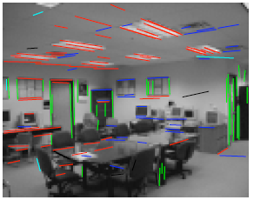
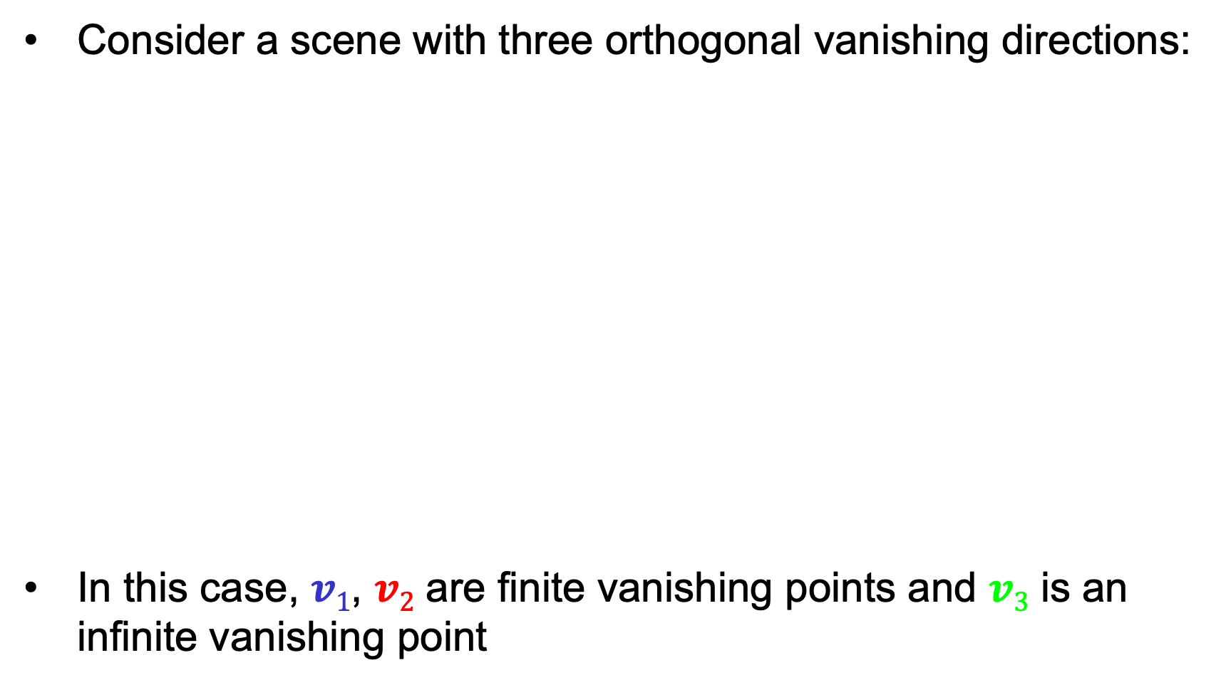



Calibration from vanishing points
Consider a scene with three orthogonal vanishing directions:
In this case, $v1$, $v2$ are finite vanishing points and $v3$ is an infinite vanishing point
.
.
$$v1$$
$$v2$$
$$v3$$
Notes:
The third homogeneous coordinate of an infinite vanishing point is 0. Infinite vanishing points correspond to directions of lines that are parallel to the image plane.

Slide 26
Calibration from vanishing points
Consider a scene with three orthogonal vanishing directions:
We can align the world coordinate system with these directions
.
.
$$v1$$
$$v2$$
$$v3$$

Slide 27

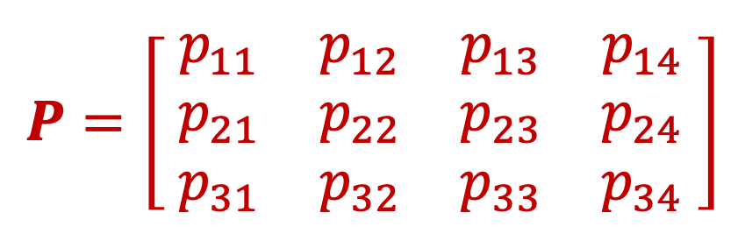



Projection of the world coordinate system
$$P=\left[\begin{matrix}{ p}_{11} & p_{12} & p_{13} & p_{14} \\ { p}_{21} & p_{22} & p_{23} & p_{24} \\ { p}_{31} & p_{32} & p_{33} & p_{34} \end{matrix}\right]$$
$$p_{1}$$
$$p_{2}$$
$$p_{3}$$
$$p_{4}$$

Slide 28

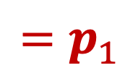
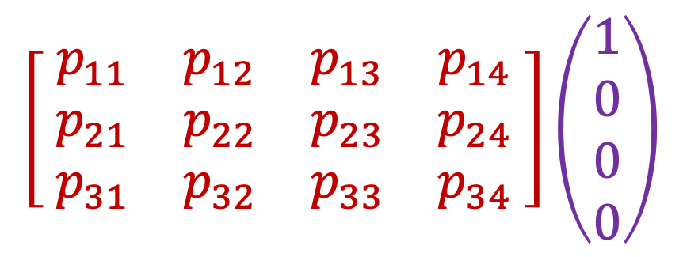

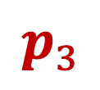
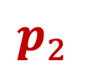
Projection of the world coordinate system
$$\left[\begin{matrix}{ p}_{11} & p_{12} & p_{13} & p_{14} \\ { p}_{21} & p_{22} & p_{23} & p_{24} \\ { p}_{31} & p_{32} & p_{33} & p_{34} \end{matrix}\right]\left(\begin{aligned}1 \\ 0 \\ 0 \\ 0\end{aligned}\right)$$
$$=p_{1}$$
$$p_{1}$$
$$p_{2}$$
$$p_{3}$$
$$p_{4}$$

Slide 29
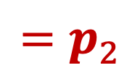
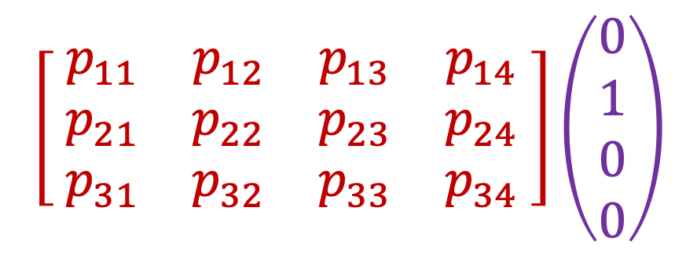
Projection of the world coordinate system
$$\left[\begin{matrix}{ p}_{11} & p_{12} & p_{13} & p_{14} \\ { p}_{21} & p_{22} & p_{23} & p_{24} \\ { p}_{31} & p_{32} & p_{33} & p_{34} \end{matrix}\right]\left(\begin{aligned}0 \\ 1 \\ 0 \\ 0\end{aligned}\right)$$
$$=p_{2}$$
$$p_{1}$$
$$p_{2}$$
$$p_{3}$$
$$p_{4}$$

Slide 30
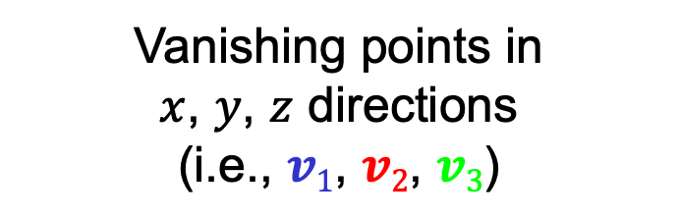
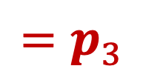
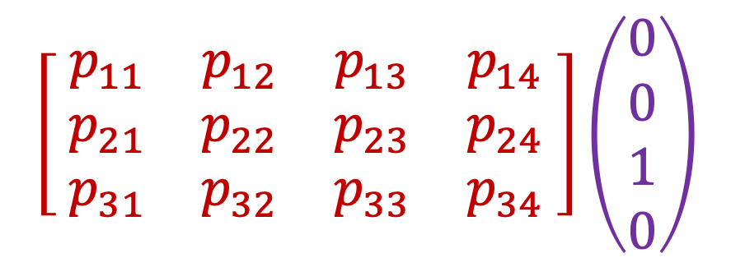
Projection of the world coordinate system
$$\left[\begin{matrix}{ p}_{11} & p_{12} & p_{13} & p_{14} \\ { p}_{21} & p_{22} & p_{23} & p_{24} \\ { p}_{31} & p_{32} & p_{33} & p_{34} \end{matrix}\right]\left(\begin{aligned}0 \\ 0 \\ 1 \\ 0\end{aligned}\right)$$
$$=p_{3}$$
$$p_{1}$$
$$p_{2}$$
$$p_{3}$$
$$p_{4}$$
Vanishing points in
$x$, $y$, $z$ directions
(i.e., $v1$, $v2$, $v3$)

Slide 31
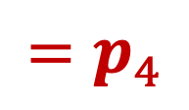
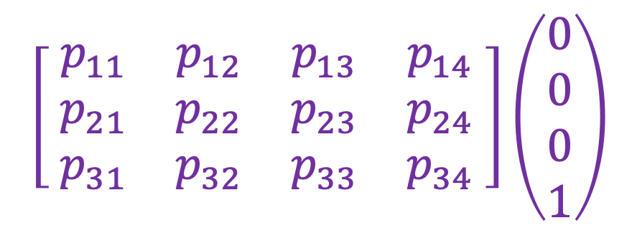
Projection of the world coordinate system
$$\left[\begin{matrix}{ p}_{11} & p_{12} & p_{13} & p_{14} \\ { p}_{21} & p_{22} & p_{23} & p_{24} \\ { p}_{31} & p_{32} & p_{33} & p_{34} \end{matrix}\right]\left(\begin{aligned}0 \\ 0 \\ 0 \\ 1\end{aligned}\right)$$
$$=p_{4}$$
$$p_{1}$$
$$p_{2}$$
$$p_{3}$$
$$p_{4}$$
Vanishing points in
$x$, $y$, $z$ directions
(i.e., $v1$, $v2$, $v3$)
Projection of world origin
Problem: this only gives us the four columns up to independent scale factors, additional constraints needed to solve for them

Slide 32
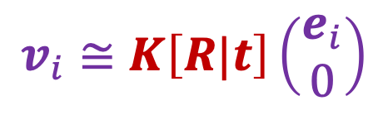
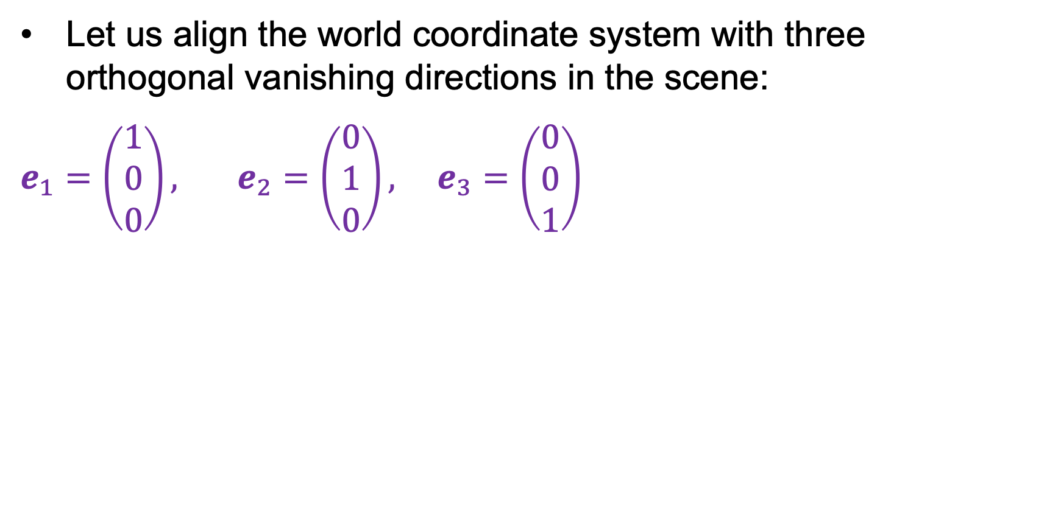
Calibration from vanishing points
Let us align the world coordinate system with three orthogonal vanishing directions in the scene:
$e_{1}=\left(\begin{aligned}1 \\ 0 \\ 0\end{aligned}\right),$ $e_{2}=\left(\begin{aligned}0 \\ 1 \\ 0\end{aligned}\right), e_{3}=\left(\begin{aligned}0 \\ 0 \\ 1\end{aligned}\right)$
$$v_{i}≅K\left[R|t\right]\left(\begin{aligned}e_{i} \\ 0\end{aligned}\right)$$

Slide 33

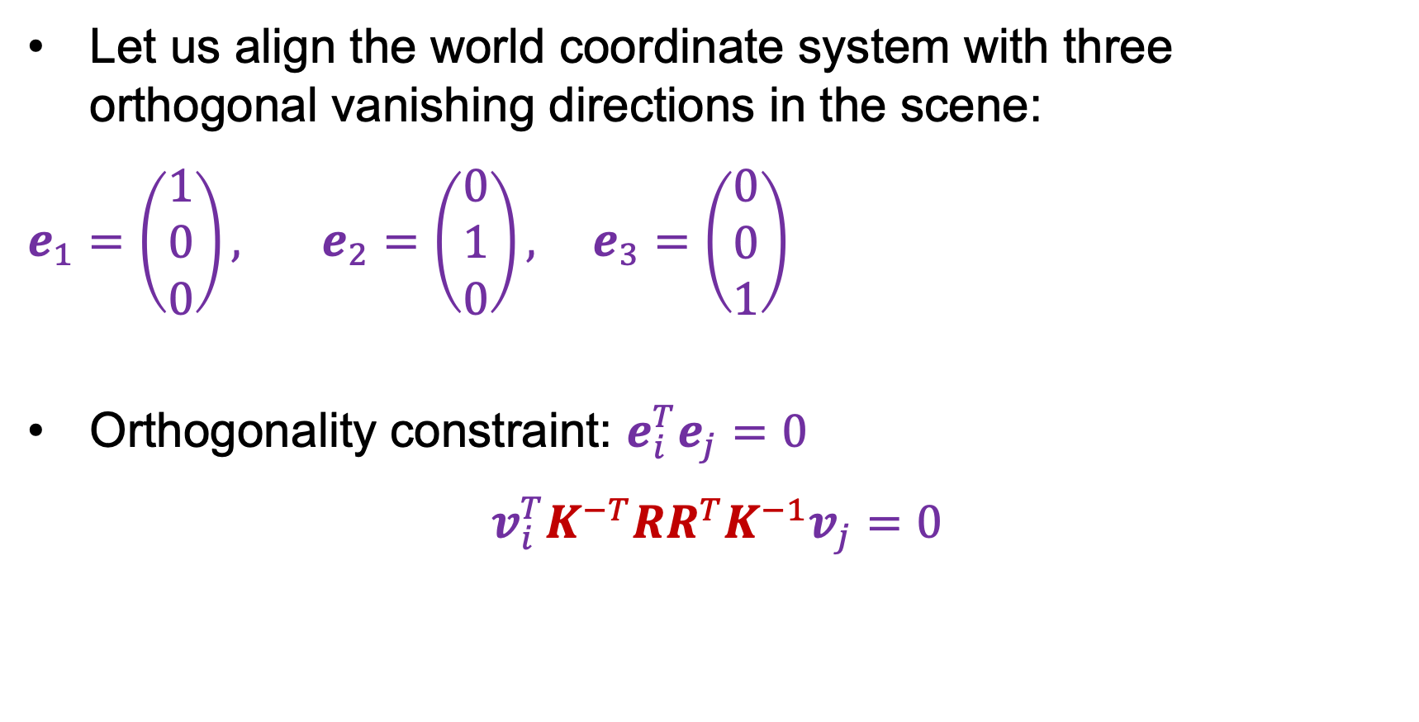



Calibration from vanishing points
Let us align the world coordinate system with three orthogonal vanishing directions in the scene:
$e_{1}=\left(\begin{aligned}1 \\ 0 \\ 0\end{aligned}\right),$ $e_{2}=\left(\begin{aligned}0 \\ 1 \\ 0\end{aligned}\right), e_{3}=\left(\begin{aligned}0 \\ 0 \\ 1\end{aligned}\right)$
Orthogonality constraint: $e_{i}^{T}e_{j}=0$
$$v_{i}^{T}K^{−T}RR^{T}K^{−1}v_{j}=0$$
$$v_{i}≅KRe_{i}$$
$$e_{i}≅R^{T}K^{−1}v_{i}$$
$$e_{i}^{T}$$
$$e_{j}$$

Slide 34
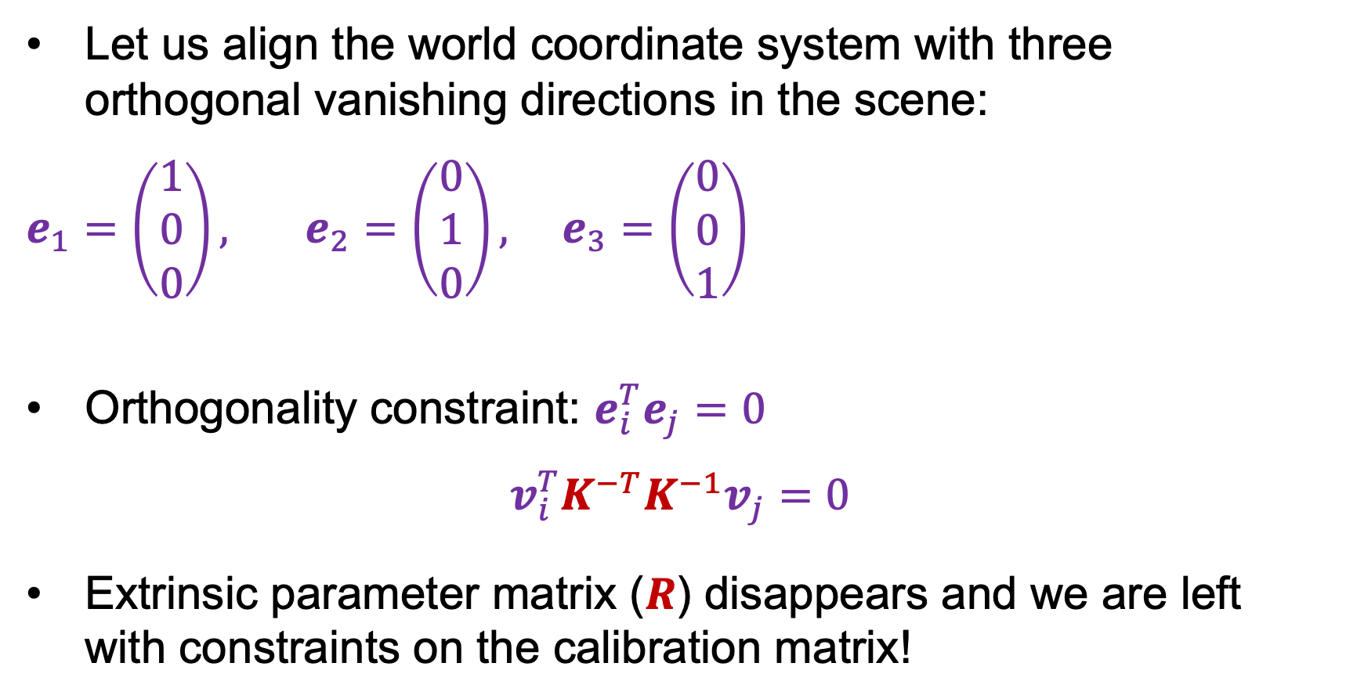
Calibration from vanishing points
Let us align the world coordinate system with three orthogonal vanishing directions in the scene:
$e_{1}=\left(\begin{aligned}1 \\ 0 \\ 0\end{aligned}\right),$ $e_{2}=\left(\begin{aligned}0 \\ 1 \\ 0\end{aligned}\right), e_{3}=\left(\begin{aligned}0 \\ 0 \\ 1\end{aligned}\right)$
Orthogonality constraint: $e_{i}^{T}e_{j}=0$
$$v_{i}^{T}K^{−T}K^{−1}v_{j}=0$$
Extrinsic parameter matrix ($R$) disappears and we are left with constraints on the calibration matrix!
$$v_{i}≅KRe_{i}$$
$$e_{i}≅R^{T}K^{−1}v_{i}$$

Slide 35
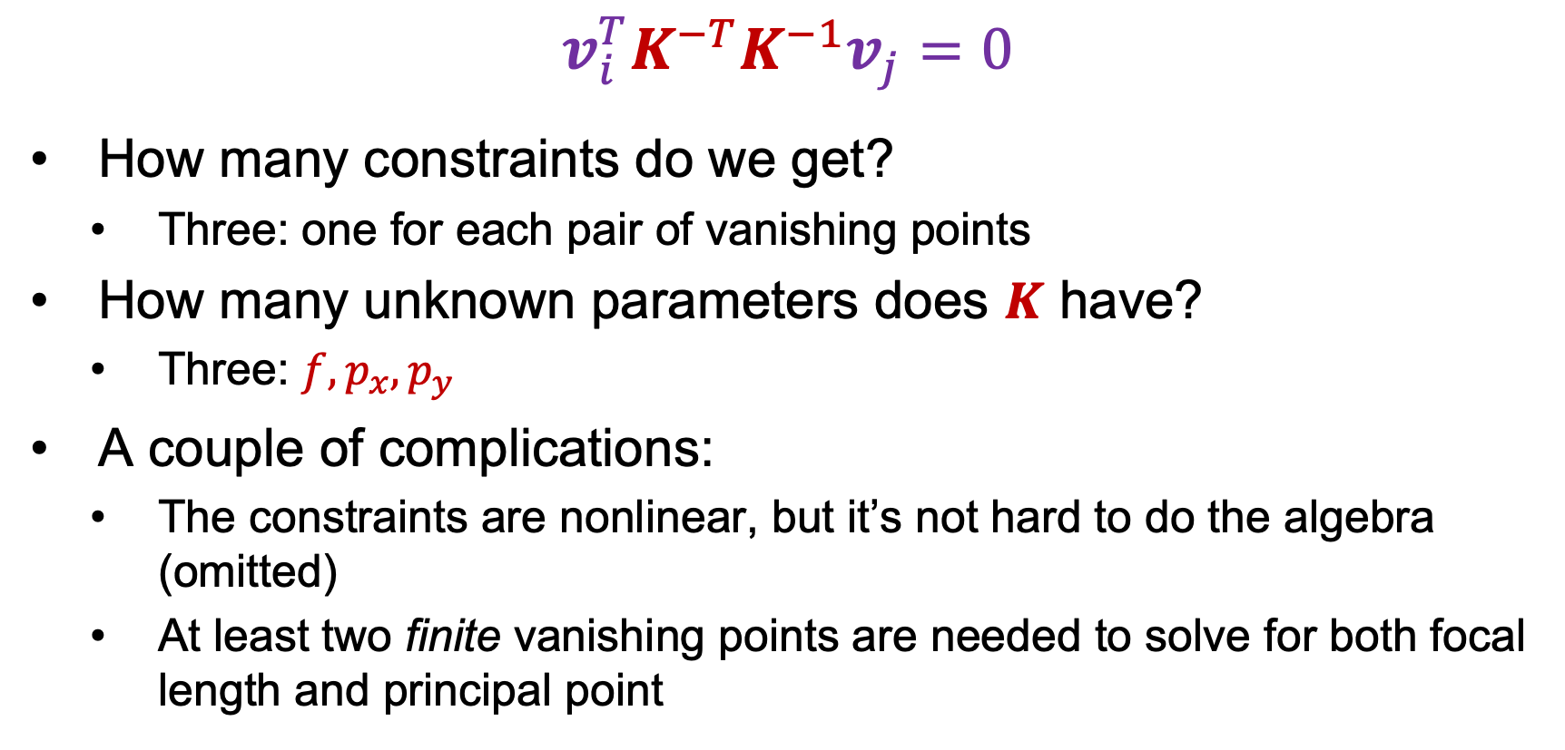
Calibration from vanishing points
$$v_{i}^{T}K^{−T}K^{−1}v_{j}=0$$
How many constraints do we get?
  Three: one for each pair of vanishing points
How many unknown parameters does $K$ have?
  Three: $f,p_{x},p_{y}$
A couple of complications:
  The constraints are nonlinear, but it’s not hard to do the algebra (omitted)
  At least two finite vanishing points are needed to solve for both focal length and principal point

Slide 36
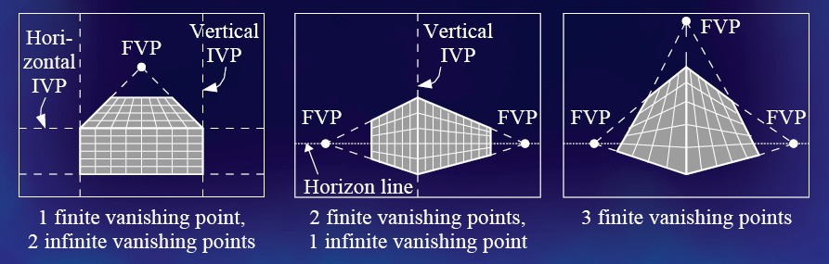
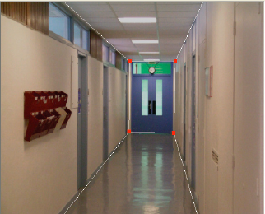
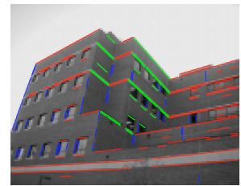
Calibration from vanishing points
Cannot recover focal length, principal point is the third vanishing point
Can solve for focal length, principal point

Slide 37

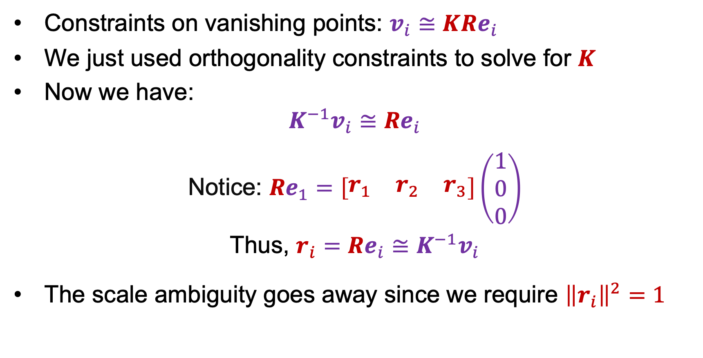
Rotation from vanishing points
Constraints on vanishing points: $v_{i}≅KRe_{i}$
We just used orthogonality constraints to solve for $K$
Now we have:
$$K^{−1}v_{i}≅Re_{i}$$
Notice: $Re_{1}=\left[\begin{matrix}r_{1} & r_{2} & r_{3}\end{matrix}\right]\left(\begin{aligned}1 \\ 0 \\ 0\end{aligned}\right)$
Thus, $r_{i}=Re_{i}≅K^{−1}v_{i}$
The scale ambiguity goes away since we require ${\left\|r_{i}\right\|}^{2}=1$
$$=r_{1}$$

Slide 38
Calibration from vanishing points: Summary
Solve for intrinsic parameters (focal length, principal point) using three orthogonal vanishing points
Get extrinsic parameters (rotation) directly from vanishing points once calibration matrix is known
Advantages
  No need for calibration chart, 2D-3D correspondences
  Could be completely automatic
Disadvantages
  Only applies to certain kinds of scenes
  It is tricky to accurately localize vanishing points
  Need at least two finite vanishing points

Slide 39

Outline
Vanishing points and lines
Camera calibration using vanishing points
Measurements from a single image
  Measuring height above the ground plane
  Measuring within planes

Slide 40

Comparing heights
Vanishing
Point
Slide by Steve Seitz

Slide 41

Measuring height with a ruler
5.4
5
Camera height
4
3.3
3
2.8
2
1
What is the height of the camera?
Slide by Steve Seitz

Slide 42
Recall: Horizon
What can the horizon tell us about the relative height of scene points and the camera?
camera
center
ground plane
Image source: S. Seitz
Notes:
Is this parachutist higher or lower than the person taking this picture?
Lower—he is below the horizon

Slide 43


Measuring height without a ruler
Goal: compute height $H$ from image measurements
Camera center
$$H$$
ground plane

Slide 44

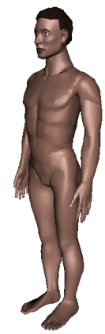
Measuring height without a ruler

Slide 45









Measuring height without a ruler
$$r$$
$$t$$
$$t0$$
$$v$$
$$H$$
$$R$$
$$H$$
$$b0$$
$$b$$
To find $\frac{H}{R}$, we need to do some extra work…

Slide 46







Measuring height
$T$: top of object
To make 3D measurements based on image observations, we need an invariant that does not change under perspective projection from 3D to 2D
$$t$$
$r$
$R$: reference point
$$C$$
H
$$b$$
R
$B$: bottom of object
ground plane

Slide 47




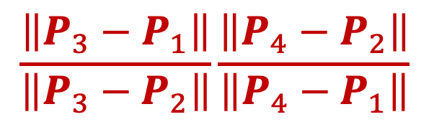
Cross-ratio
Defined for four collinear points, invariant to projective transformations, including perspective projection from 3D to 2D
  Also invariant to permutation of the points
$$\frac{\left\|P_{3}−P_{1}\right\|}{\left\|P_{3}−P_{2}\right\|}\frac{\left\|P_{4}−P_{2}\right\|}{\left\|P_{4}−P_{1}\right\|}$$
$$P4$$
$$P3$$
$$P2$$
$$P1$$

Slide 48





Measuring height
We need a fourth point to compute a cross-ratio – what could it be?
$T$: top of object
$$t$$
$r$
$R$: reference point
$$C$$
H
$$b$$
R
$B$: bottom of object
ground plane

Slide 49

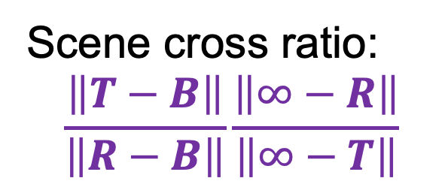

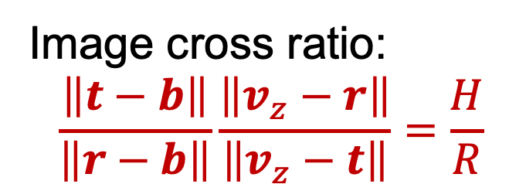
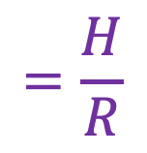
Measuring height
We need a fourth point to compute a cross-ratio – what could it be?
∞: vertical vanishing point
Scene cross ratio:
$$\frac{\left\|T−B\right\|}{\left\|R−B\right\|}\frac{\left\|∞−R\right\|}{\left\|∞−T\right\|}$$
$$=\frac{H}{R}$$
$T$: top of object
$$t$$
$r$
$R$: reference point
$$C$$
H
Image cross ratio:
$$\frac{\left\|t−b\right\|}{\left\|r−b\right\|}\frac{\left\|v_{z}−r\right\|}{\left\|v_{z}−t\right\|}=\frac{H}{R}$$
$$b$$
R
$$vZ$$
$B$: bottom of object
ground plane

Slide 50








$$vz$$
$$r$$
How do we compute the coordinates of $v$ and $t$?
$$t0$$
$$t$$
$$v$$
$$H$$
$$R$$
$$b0$$
$$b$$
Image cross-ratio:
$$\frac{\left\|t−b\right\|}{\left\|r−b\right\|}\frac{\left\|v_{z}−r\right\|}{\left\|v_{z}−t\right\|}=\frac{H}{R}$$

Slide 51

2D lines in homogeneous coordinates
Line equation: $ax+by+c=0$
We can write this as $l^{T}x=0$, where $l=\left(\begin{aligned}a \\ b \\ c\end{aligned}\right), x=\left(\begin{aligned}x \\ y \\ 1\end{aligned}\right)$
How can we obtain the coefficient vector of line $l$passing through two points $x_{1}$ and $x_{2}$?
  We want $l$ s.t. $l^{T}x_{1}=0$, $l^{T}x_{2}=0$
  This is given by $l=x_{1}×x_{2}$
What about point $x$ that is the intersection of two lines $l_{1}$and $l_{2}$?
  $x=l_{1}×l_{2}$
  What happens if $l_{1}$ and $l_{2}$ are parallel?

Slide 52




$$vz$$
$$r$$
$$v≅\left(b×b_{0}\right)×\left(v_{x}×v_{y}\right)$$
$$t0$$
$$t≅\left(v×t_{0}\right)×\left(r×b\right)$$
$$t$$
$$vx$$
$$v$$
$$vy$$
$$H$$
$$R$$
$$b0$$
$$b$$
Image cross-ratio:
$$\frac{\left\|t−b\right\|}{\left\|r−b\right\|}\frac{\left\|v_{z}−r\right\|}{\left\|v_{z}−t\right\|}=\frac{H}{R}$$

Slide 53


Height measurement examples
That booth is still there! (Oxford, September 2022)
A. Criminisi, I. Reid, and A. Zisserman, Single View Metrology, IJCV 2000
Figure from UPenn CIS580 slides

Slide 54

Height measurement examples
A. Criminisi, I. Reid, and A. Zisserman, Single View Metrology, IJCV 2000
Figure from UPenn CIS580 slides

Slide 55

Another example
Are the heights of the two groups of people consistent with one another?
  Measure heights using Christ as reference
Piero della Francesca, Flagellation, ca. 1455
A. Criminisi, M. Kemp, and A. Zisserman,Bringing Pictorial Space to Life: computer techniques for the analysis of paintings,
Proc. Computers and the History of Art, 2002

Slide 56
Locating a 3D point on the ground plane

Slide 57





Locating a 3D point on the ground plane
Assuming that $x$ is a projection of a point on the ground plane, how do we reconstruct $X$?
First, find the direction $x_{∞}$ in space corresponding to image point $x$:
$$x≅K\left[R|0\right]\left(\begin{aligned}x_{∞} \\ 0\end{aligned}\right)$$
$$x≅KRx_{∞}$$
$$x_{∞}≅R^{T}K^{−1}x$$
Recall: knowing the camera calibration allows us to map points in the image to visual ray directions in space!
$$C$$
$$x$$
$$X$$
ground plane

Slide 58

Locating a 3D point on the ground plane
Assuming that $x$ is a projection of a point on the ground plane, how do we reconstruct $X$?
First, find the direction $x_{∞}$ in space corresponding to image point $x$:
$$x_{∞}≅R^{T}K^{−1}x$$
The vertical vanishing direction is the normal to the plane. Let’s say it’s the $z$ direction. Then the equation of the ground plane is $z=−h$, where $h$ is the height of the camera above the ground plane
Finally, all we need to do is scale $x_{∞}$so that its third entry is equal to $−h$, and append a 1 to get $X$
$$C$$
$$x$$
h
$$X$$
ground plane

Slide 59


Measurements within planes
4
3
2
1
1
2
3
4
Simplest approach: unwarp then measure
Notes:
homography!

Slide 60



Image rectification
$$x′$$
$$x$$
To unwarp (rectify) an image, solve for homography $H$ given four pairs of matches assumed to have a known configuration (e.g., square)

Slide 61
Image rectification: Example

Slide 62


Putting everything together: Single-view modeling
A. Criminisi et al. Bringing Pictorial Space to Life: computer techniques for the analysis of paintings,
Proc. Computers and the History of Art, 2002

Slide 63
Putting everything together: Single-view modeling
J. Vermeer, Music Lesson, 1662
A. Criminisi et al. Bringing Pictorial Space to Life: computer techniques for the analysis of paintings,
Proc. Computers and the History of Art, 2002

Slide 64




Putting everything together: Single-view modeling
A. Criminisi et al. Single View Metrology. IJCV 2000

Slide 65
Outline
Vanishing points and lines
Camera calibration using vanishing points
Measurements from a single image
Applications of single-view metrology

Slide 66





Application: Fully automatic modeling
sky
vertical
ground
D. Hoiem, A.A. Efros, and M. Hebert, Automatic Photo Pop-up, SIGGRAPH 2005

Slide 67

Application: Object detection
D. Hoiem, A.A. Efros, and M. Hebert. Putting Objects in Perspective. CVPR 2006

Slide 68



Application: Object Detection
$$y_{object}≈\frac{h∙y_{camera}}{v_{0}−v}$$
“Reasonable” approximation:
Source: D. Hoiem, J. Johnson and D. Fouhey

Slide 69

Application: Object detection
D. Hoiem, A.A. Efros, and M. Hebert. Putting Objects in Perspective. CVPR 2006

Slide 70


Application: Image editing
Inserting synthetic objects into images
K. Karsch and V. Hedau and D. Forsyth and D. Hoiem. Rendering Synthetic Objects into Legacy Photographs. SIGGRAPH Asia 2011

Slide 71

Application: Image editing
Inserting synthetic objects into images:
K. Karsch and V. Hedau and D. Forsyth and D. Hoiem. Rendering Synthetic Objects into Legacy Photographs. SIGGRAPH Asia 2011

